Slide 1
Excel Dashboards: Unlocking insights with data visualization

Slide 2
Agenda
Overview
Importance of data visualization in businesses
Key components
Design Principles
Example

Slide 3
OVERVIEW Excel dashboards are valuable tools for organizations and individuals looking to gain insights from their data, monitor performance, and drive informed decision-making. By leveraging the power of data visualization and interactivity, Excel dashboards empower users to unlock the full potential of their data and drive business success.

Slide 4
IMPORTANCE OF DATA VISUALIZATION IN BUSINESSES Improved Decision-Making: Visualizations enable decision-makers to quickly grasp insights and trends from large datasets, empowering them to make informed decisions promptly. By presenting data in a visually compelling manner, businesses can identify opportunities, detect potential risks, and optimize strategies more effectively, leading to better outcomes and competitive advantages. Effective Communication: Visual representations simplify complex concepts and facilitate storytelling, enabling stakeholders to grasp key messages more easily and engage with data-driven narratives more effectively. Identification of Patterns and Trends: Whether it's analyzing sales trends, customer behavior, or market dynamics, visualizations provide a visual framework for exploring data and extracting meaningful insights that drive business growth and innovation.

Slide 5
Excel Formulas
Excel functions
Excel pivot tables
Excel charts
Background layout
KEY COMPONENTS

Slide 6
Excel Formulas
Sum =Sum(C2:C4)
Average =Average(C2, C3, C4)
Count =Count(C1:C4)
Vlookup = VLOOKUP(lookup_value, table_array, col_index_number, (range_lookup))
Hlookup = HLOOKUP(lookup_value, table_array, row_index_num, (range_lookup))

Slide 7
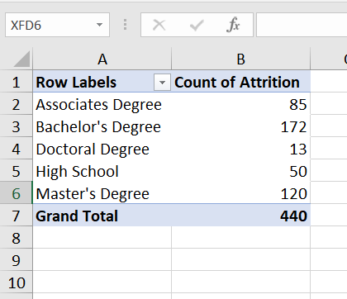
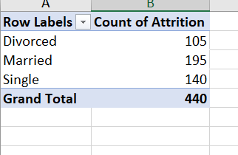
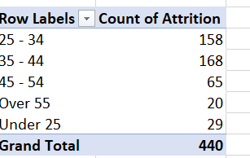
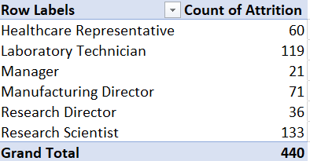
Excel Pivot tables

Slide 8
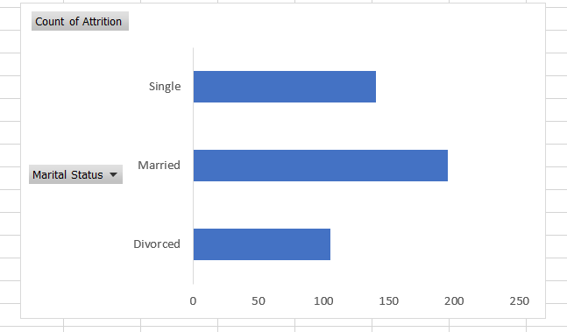
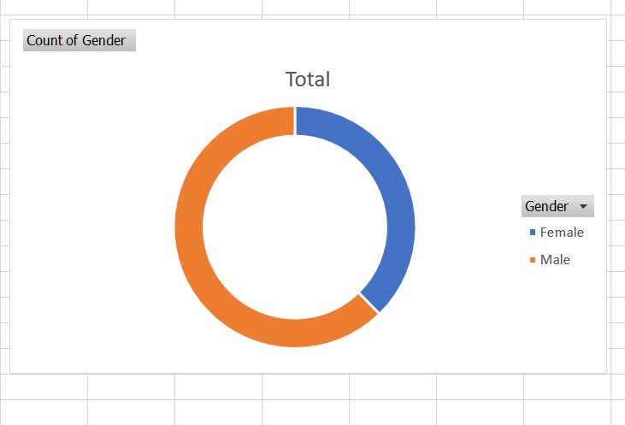
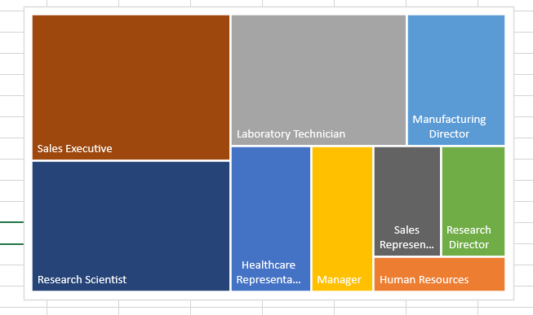
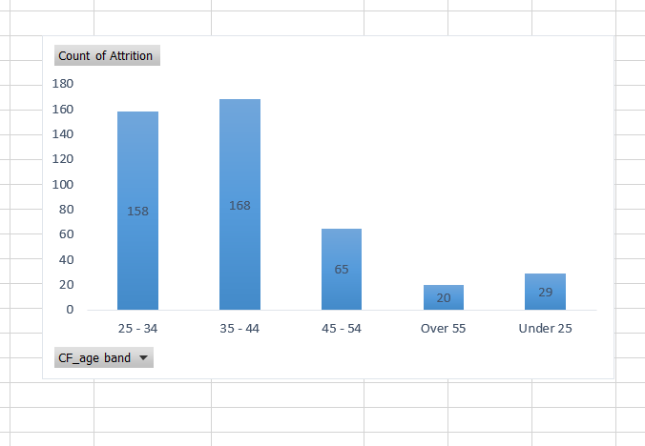
Excel Charts

Slide 9
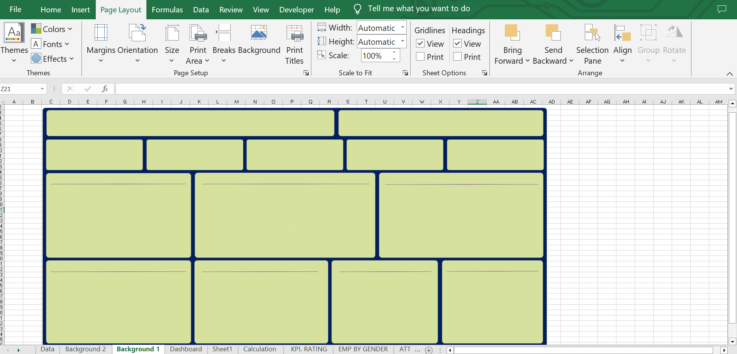
Background Layout

Slide 10
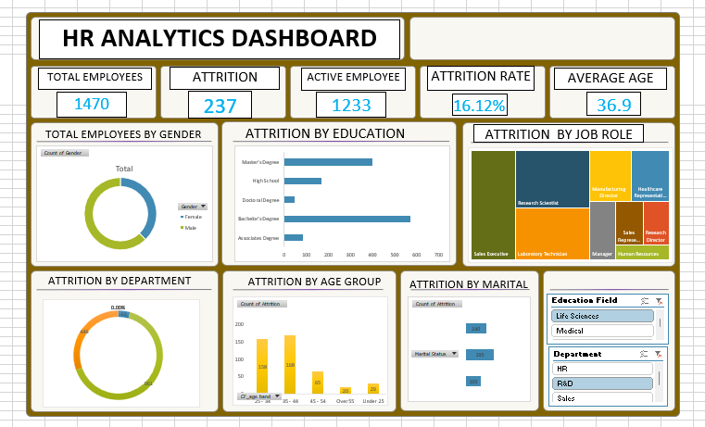
Example – HR ANALYTICS DASHBOARD

Slide 11
Design Principles

Slide 12
Focus on Key Metrics (KPIs):
Highlight key performance indicators (KPIs) and critical metrics prominently to draw attention to areas that require action or further analysis.
Use visual cues such as color coding, icons, or sparklines to emphasize changes in KPIs and trends over time.
Effective Data Visualization:
Choose the right charts and graphs to represent different types of data effectively. For example, use line charts for trends over time, bar charts for comparisons, and pie charts for proportions.
Avoid unnecessary chart types or visualizations that may confuse users or distort the data.
User-Friendly Navigation:
Design the dashboard layout and navigation in a logical and intuitive manner to guide users through the content seamlessly.
Provide clear instructions and tooltips to help users understand how to interact with the dashboard and interpret the data.
Accessibility:
Ensure that the dashboard is accessible to all users, including those with disabilities, by following accessibility guidelines for color contrast, text size, and navigation.
Provide alternative text descriptions for visual elements and charts to assist screen readers.

Slide 13
Thank you
Nishtha Pitroda
200050131150
8th semester
BITS

